Slide 1
CSE-5325-005-SFWR ENG II: MGMT, MAIN, & QA
Online LMS
Team Members
Jaydeep Mojidra
Pranjal Kamboj
Samyak Jain
Dhruv Shah

Slide 2
Agenda
PROJECT SUMMARY
SDLC MODEL
WBS
TOOLS AND FRAMEWORK
RESOURCE ALLOCATION
GANTT CHART
COST ESTIMATION
FUNCTION POINT ESTIMATION
ER DIAGRAM
UML DIAGRAM
BURNDOWN CHART
USER INTERFACE SNAPS
TESTING RESULTS
RISK FACTORS
QUALITY ASSURANCE
MANAGEMENT TOOL
FUTURE SCOPE
REFERENCES

Slide 3
Project Summary
We developed an LMS tailored for managing university-level courses, designed to enhance both teacher and student experiences.
For Teachers: Create and manage courses, assignments, and grades efficiently.
For Students: Explore courses, enroll, submit assignments
The system ensures seamless functionality for course creation, student enrollment, assignment management, and grading, with a focus on performance, scalability, and usability.

Slide 4
Agile Model
We used the Agile SDLC model for our LMS project as it allowed us to develop features incrementally through iterative sprints. This approach enabled flexibility in accommodating changes, continuous feedback through tools like Postman and Git, and ensured high-quality deliverables. Agile helped us prioritize user-centric design by refining React and Material-UI components based on feedback, while fostering seamless collaboration between frontend and backend teams for efficient and timely deployment.

Slide 5
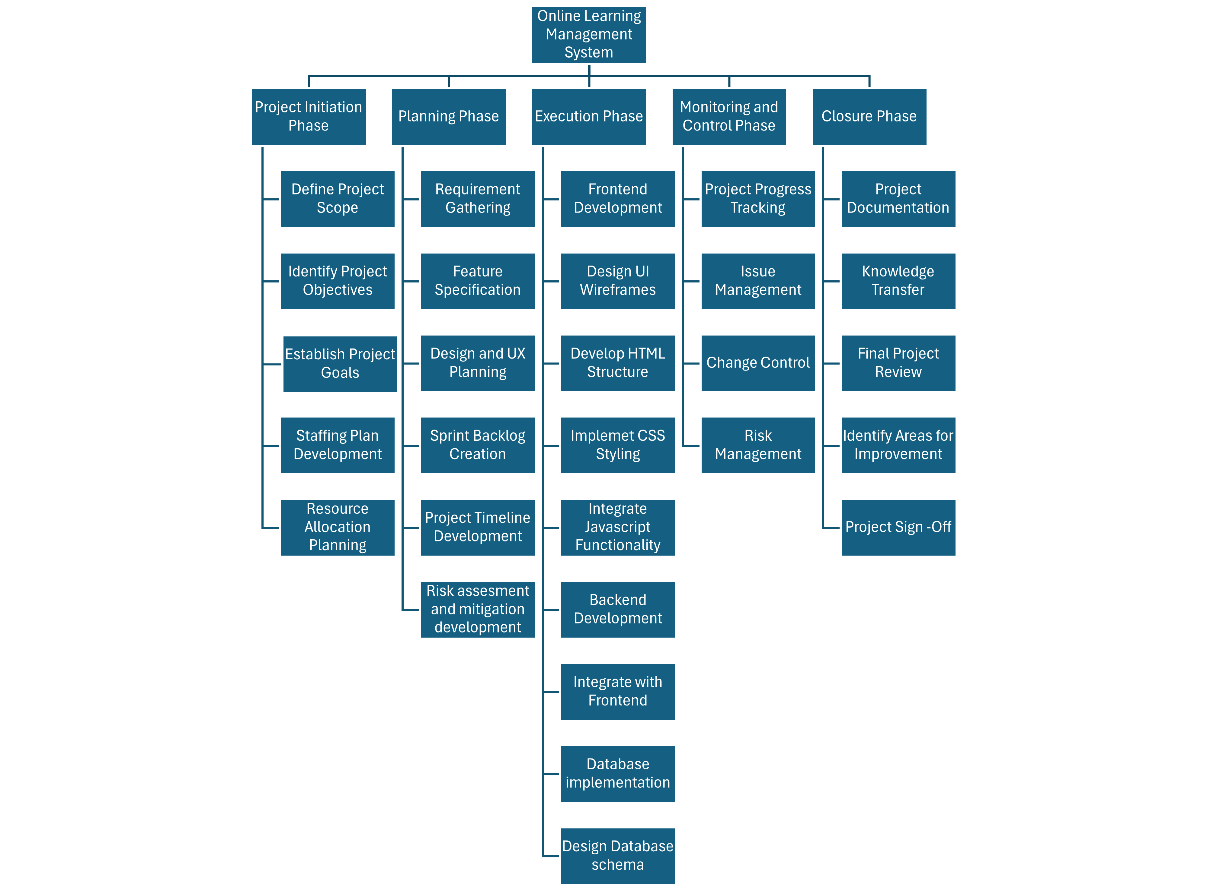
WBS

Slide 6
Tools and Framework
Backend
Express.js: Used as the main framework for the backend server, facilitating the creation of RESTful APIs.
MySQL: Used as the database to store user data, course details, assignments, submissions, and grades.
Sequelize: An ORM (Object-Relational Mapping) tool that enabled us to manage MySQL databases through JavaScript models, simplifying database queries and data management.
Multer: Used for handling file uploads, specifically for assignment submissions.
Nodemailer: Implemented for sending email notifications, especially for registration confirmations or grade updates.
dotenv: Managed environment variables securely, including database credentials and API keys.
Frontend
React: Used as the main library for building the user interface, enabling efficient state management and dynamic page rendering.
Material-UI: Provided pre-styled components for creating a responsive, user-friendly interface with minimal custom CSS.
Axios: A promise-based HTTP client used to handle API requests and responses between the frontend and backend.
Other Important Tools
Visual Studio Code
Postman - Used for API endpoint testing and verification.
Excel
GitHub , Jira

Slide 7
Resource Allocation
Jaydeep Mojidra - Frontend Development (React)
Pranjal Kamboj – Backend Development (Node.js)
Samyak Jain - Backend Development (Express.js) and API Testing and verification
Dhruv Shah - Frontend Development (React) and Database (MySQL)

Slide 8
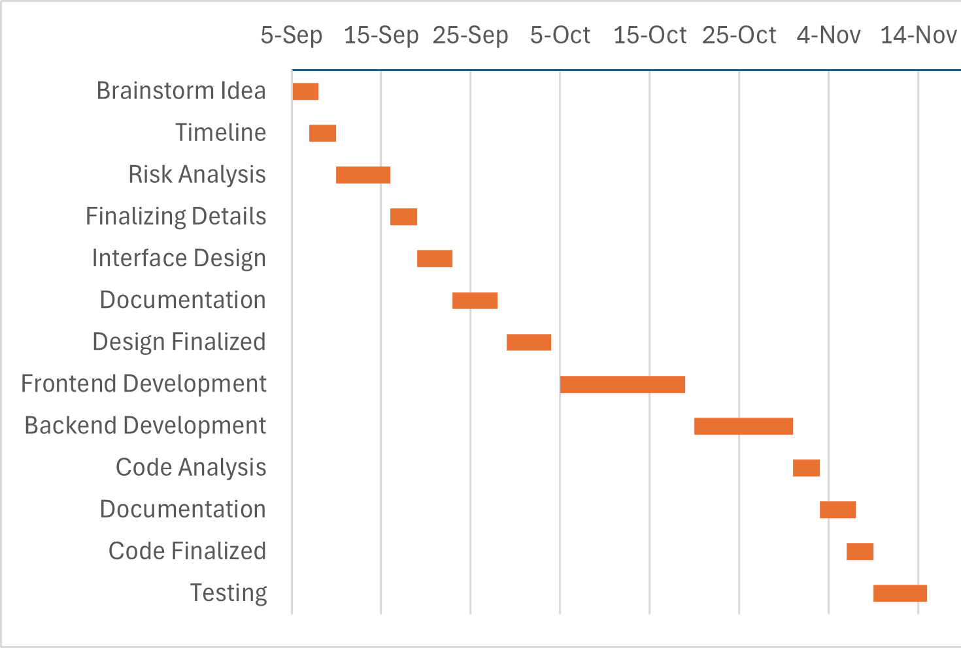
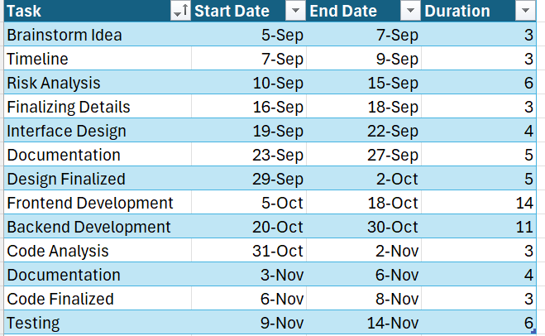
Gantt Chart

Slide 9
Table For Each Person Task and Responsibilities
Tasks | Assigned Task
Gathering Requirements | Jaydeep, Pranjal, Samyak, Dhruv
User Interface Design | Samyak, Dhruv
Implementation | Jaydeep, Pranjal
Testing | Jaydeep, Pranjal, Samyak, Dhruv
Debugging | Jaydeep, Pranjal, Samyak, Dhruv
Documentation | Jaydeep, Pranjal, Samyak, Dhruv

Slide 10
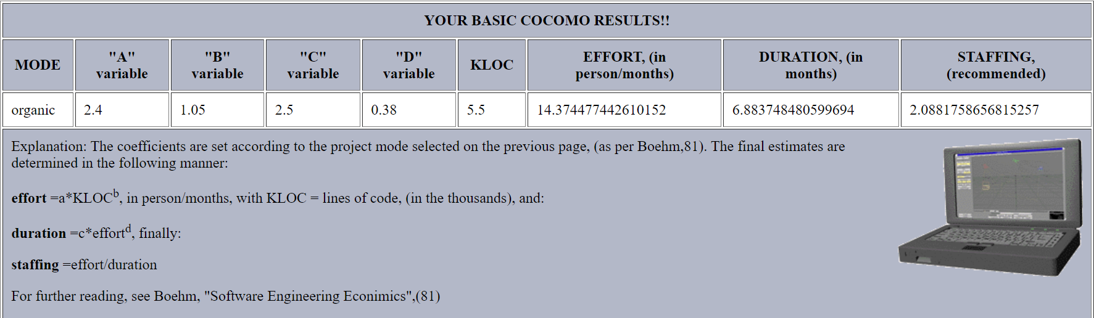
Cost Estimation

Slide 11
Function Point Estimation
External Inputs (EI): Forms, buttons, or any input from users (e.g., login forms)
External Outputs (EO): Reports, notifications, data shown to users.
User Inquiries (EQ): Search functionality, data retrieval.
Internal Logical Files (ILF): Internal databases or tables (courses, students).
External Interface Files (EIF): External systems like external grading systems
For our project:
EI: 5 (login, course creation, assignment submission, etc.)
EO: 5 (grades, announcements, etc.)
EQ: 3 (search courses, view grades)
ILF: 3 (student, course, and assignment data)
EIF: 5 (external APIs or external reports)
So, we get total 90 weighted measures and 0.65 factor so we get 59 Function points

Slide 12
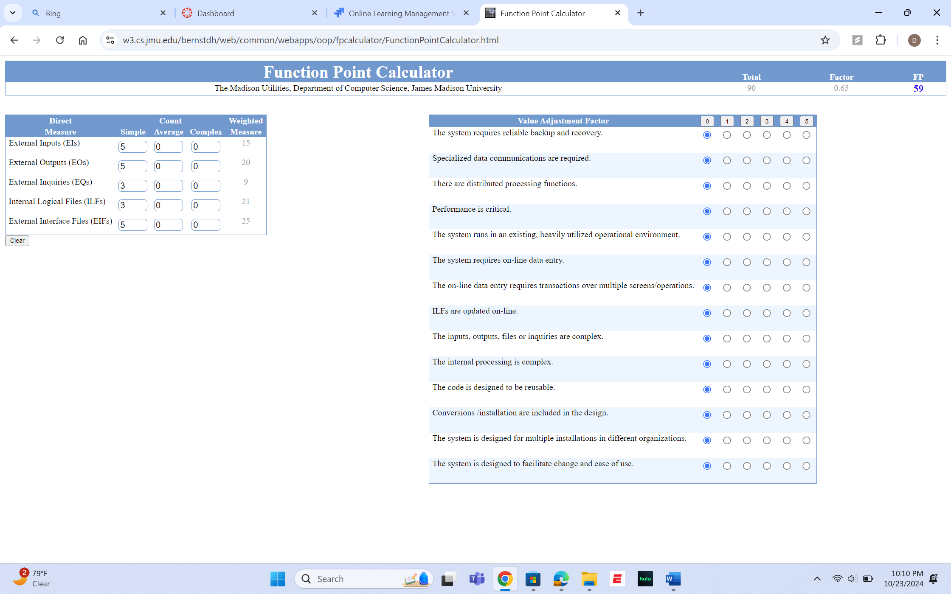

Slide 13
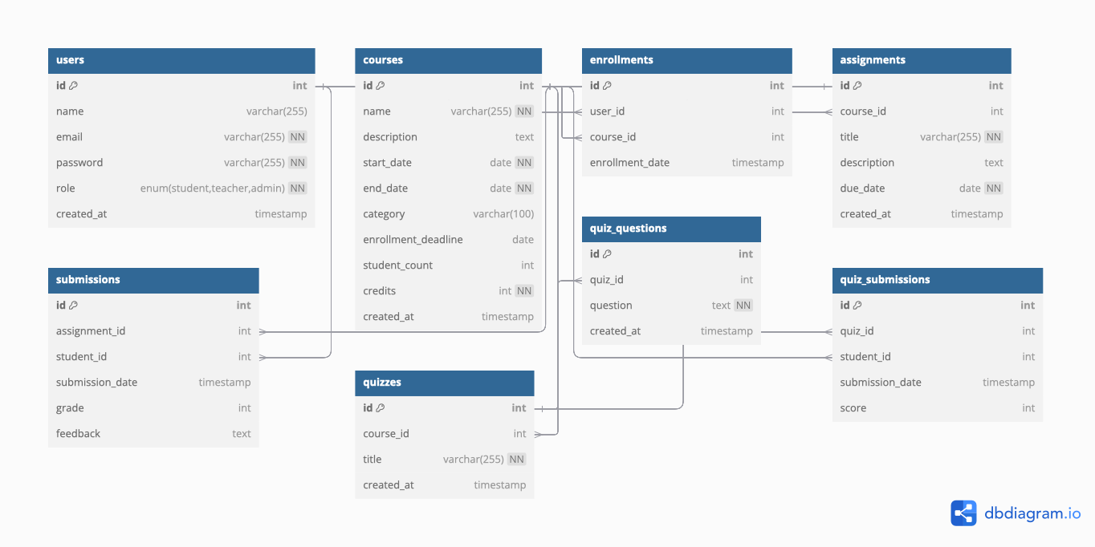
ER Diagram

Slide 14
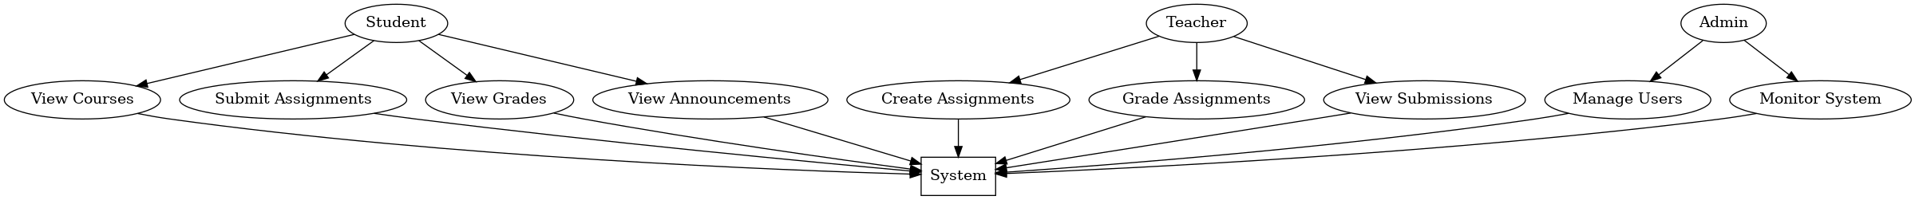
UML Diagram

Slide 15
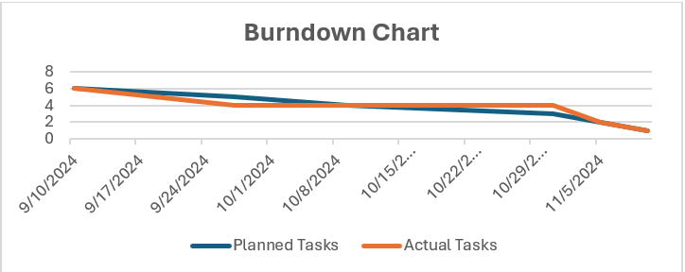
Burndown Chart

Slide 16
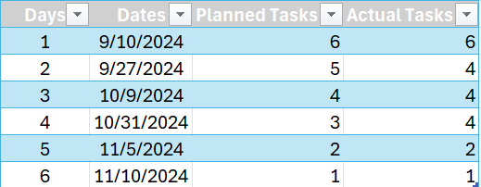
Reasons for deviation from the planned curve:
Task Complexity: Some tasks, like backend integration of course management or grading, required more time than initially anticipated due to unforeseen technical challenges, such as handling dynamic UI updates or ensuring smooth data flow between components.

Slide 17
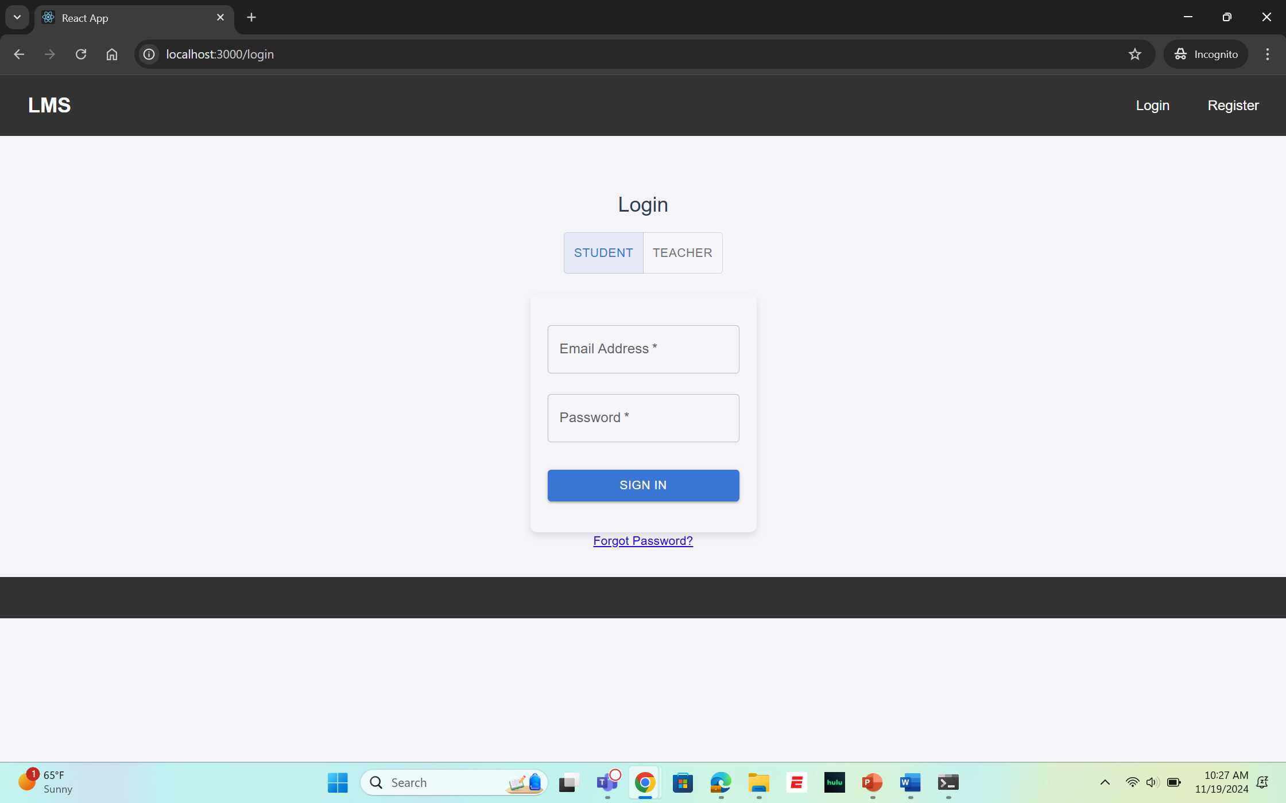
UI Snaps
LOGIN (For Both Student and Teacher)

Slide 18
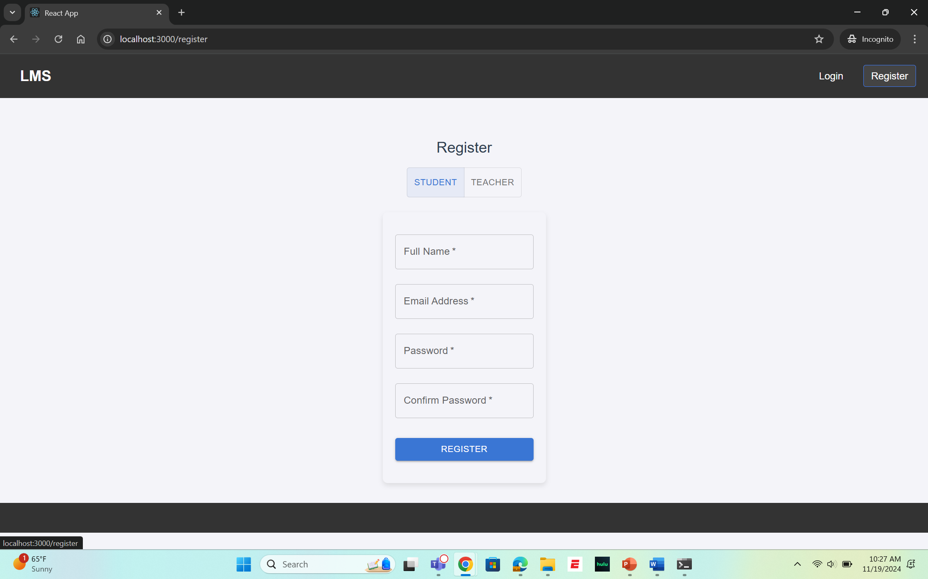
UI Snaps
Register ( For Student and Teacher)

Slide 19
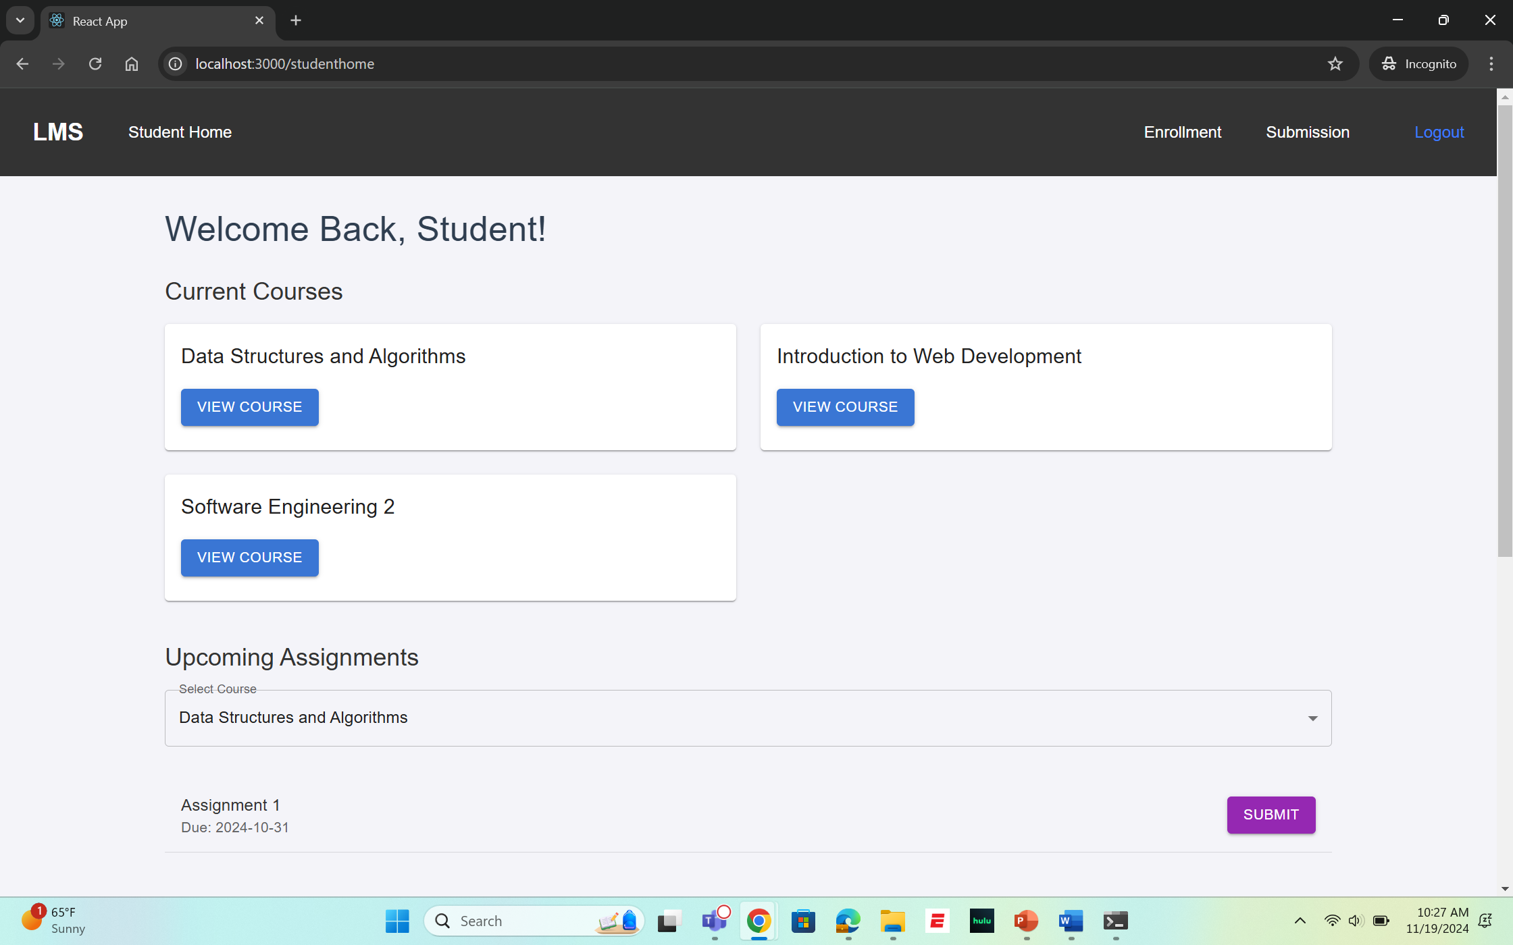
UI Snaps
Student Home Page

Slide 20
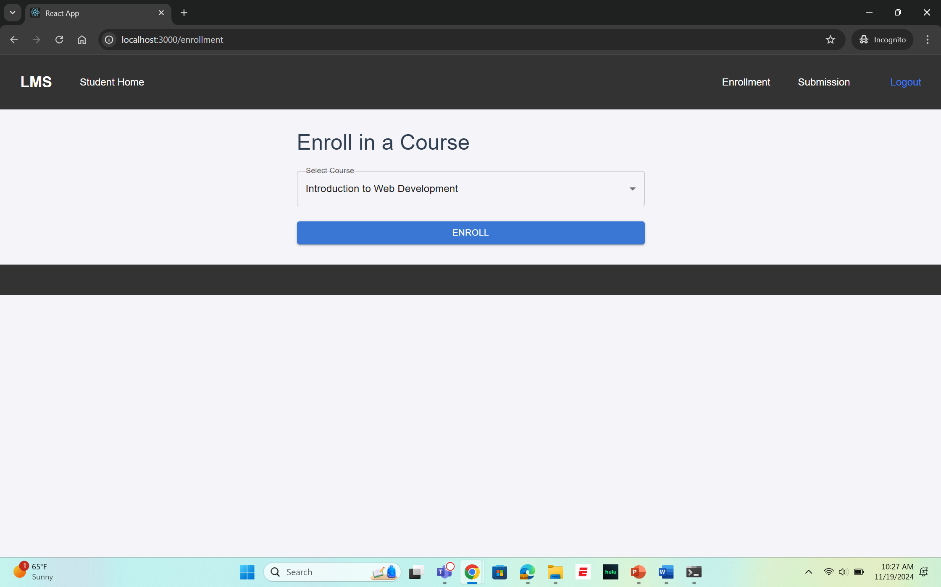
UI Snaps
Course Enrollment

Slide 21
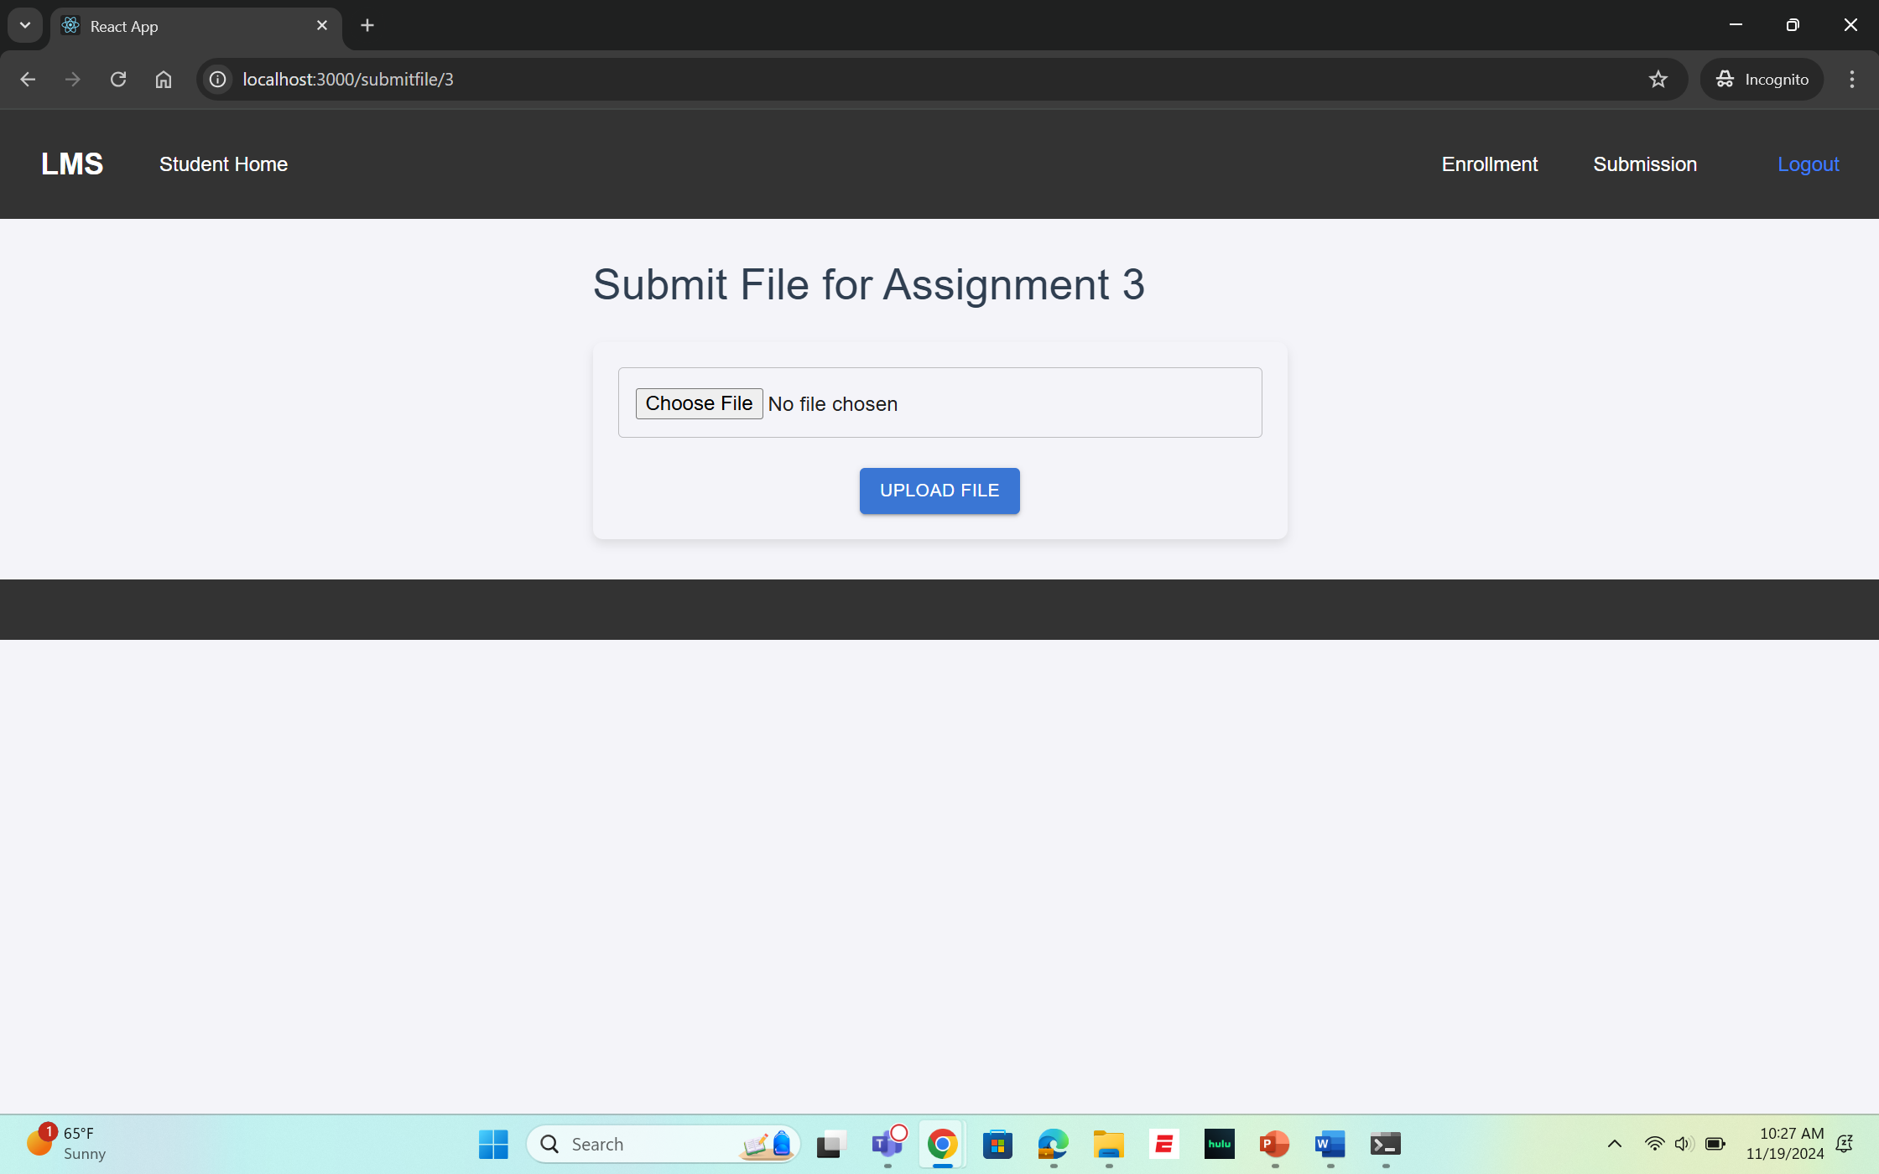
UI Snaps
Assignment Submission

Slide 22
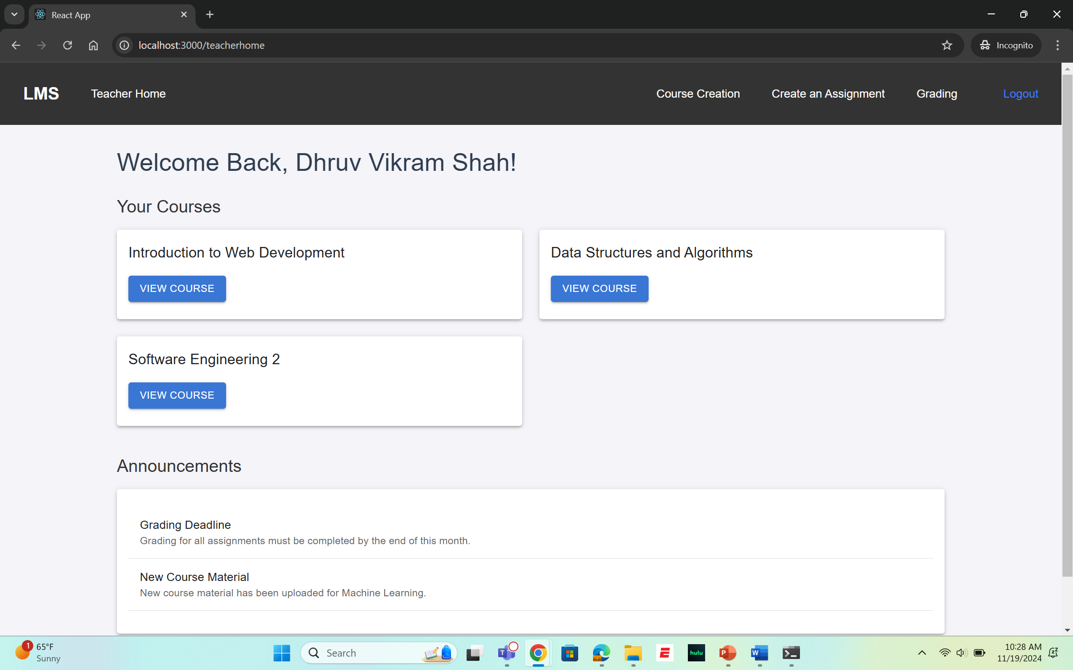
UI Snaps
Teacher Home Page

Slide 23
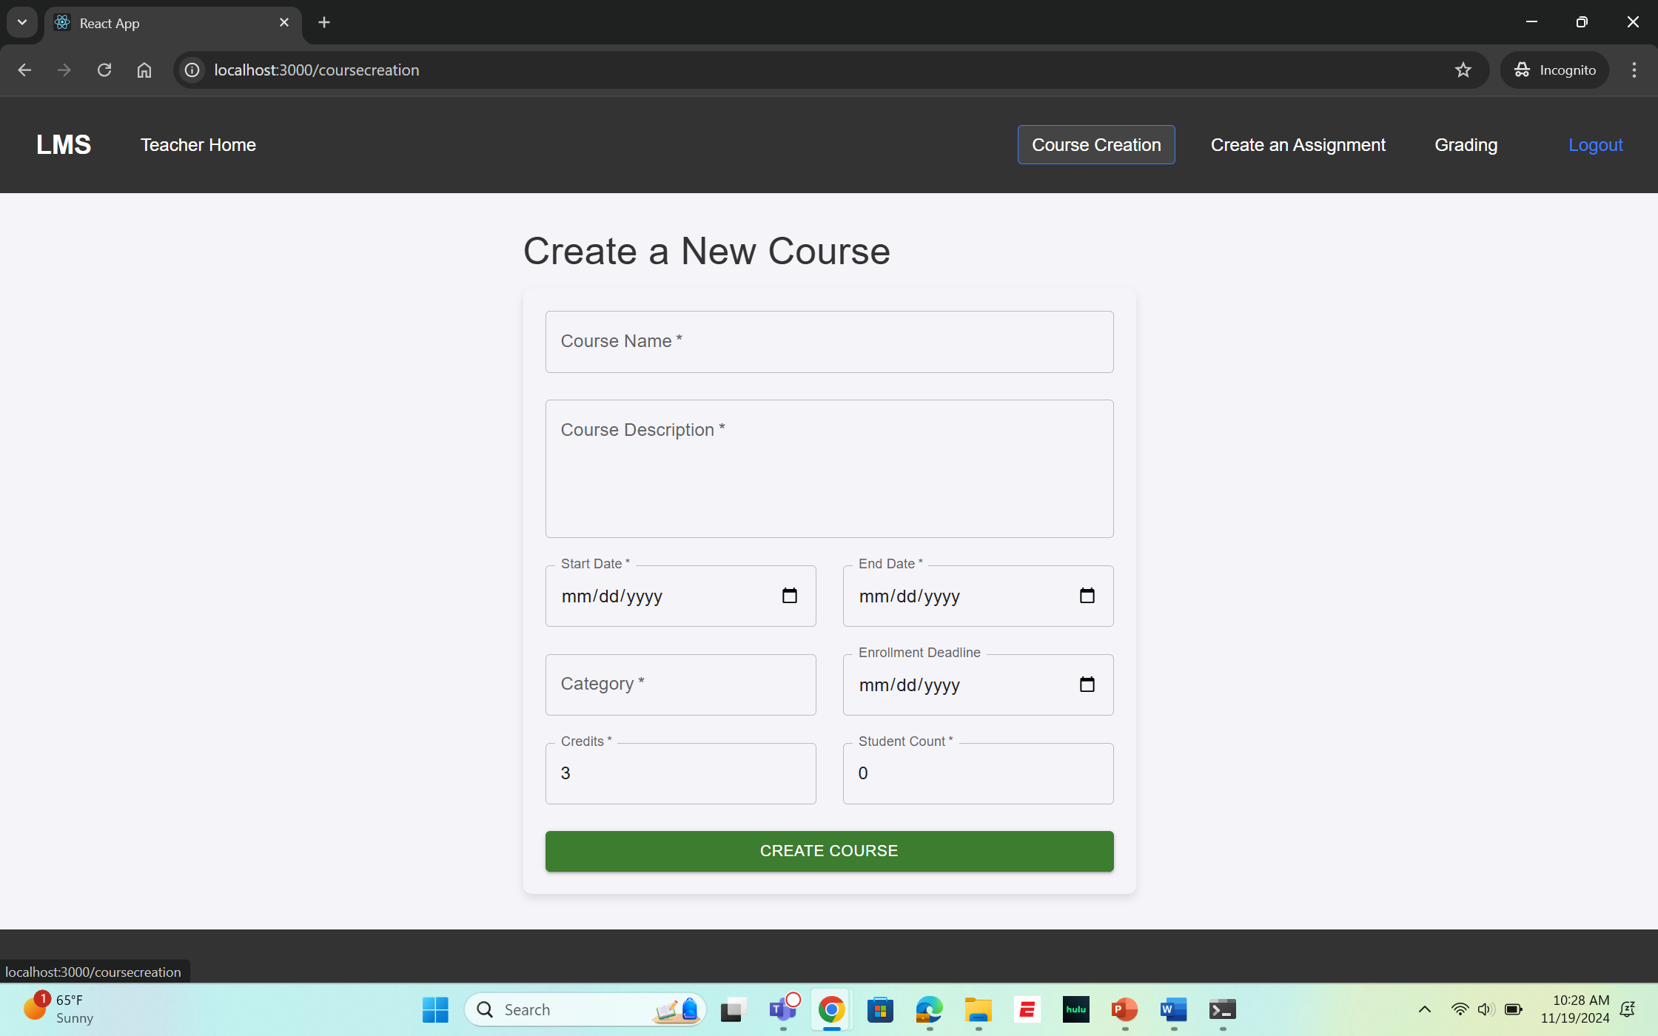
UI Snaps
Course Creation

Slide 24
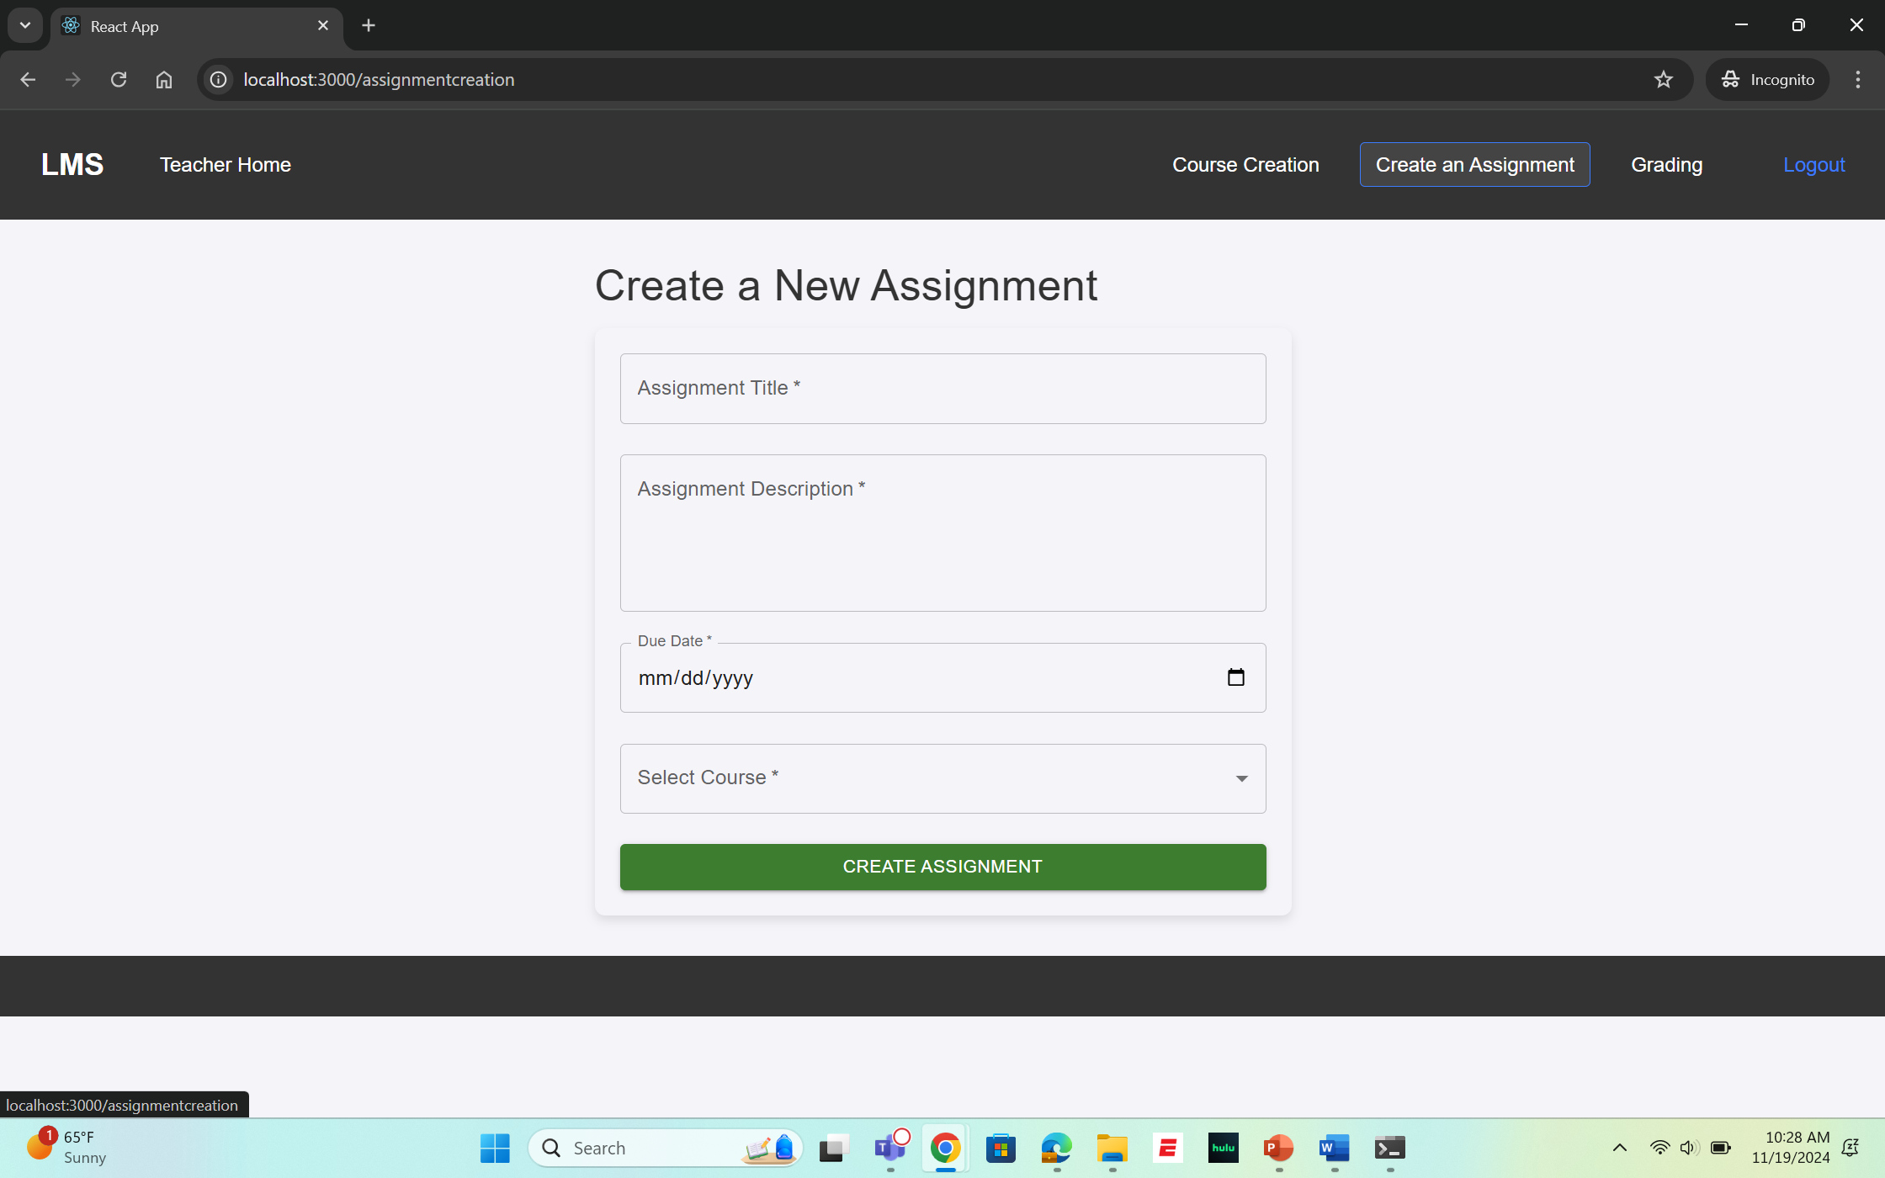
UI Snaps
Assignment Creation

Slide 25
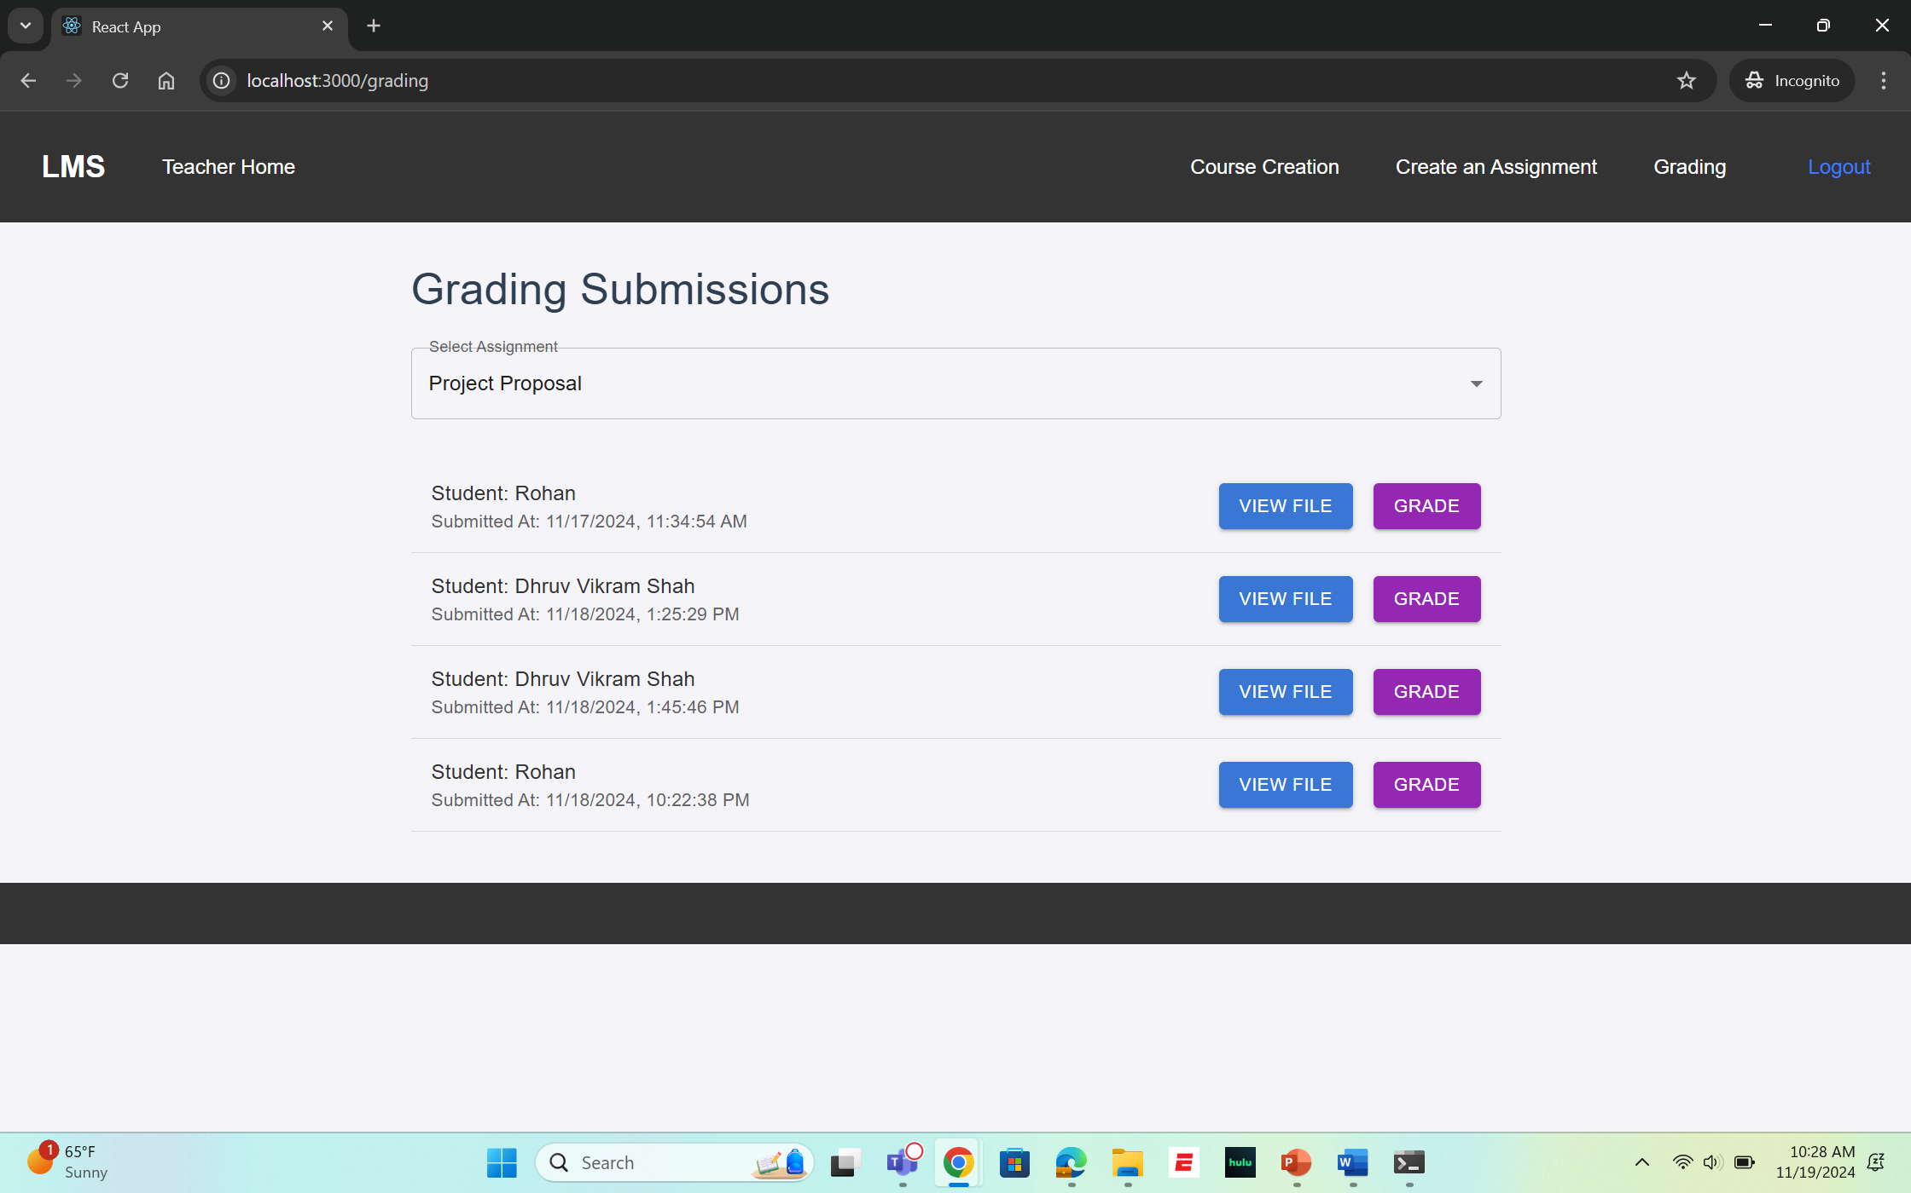
UI Snaps
Grading

Slide 26
Unit Testing Results
Test Case No. | Test Cases | Expected Results | Actual Results | Status
1 | Test User Login Functionality | Valid Email and Password and successfully logged in | Login Successful , Redirects to Dashboard | Pass
2 | Test Invalid Credentials | Invalid Email and Password and unsuccessful login | Error Message “Invalid Credentials” | Pass
3 | Test Course Creation Functionality | Valid Course data , teacher successfully should create a course | Course Created , displayed on teacher’s page | Pass
4 | Test Assignment submission functionality by student | Student should be able to successfully submit his file and it should be a valid submission | Assignment submitted successfully | Pass
5 | Test Course Enrollment by Student | Student should be able to enroll in his selected course | Enrollment Successful , Student Listed | Pass

Slide 27
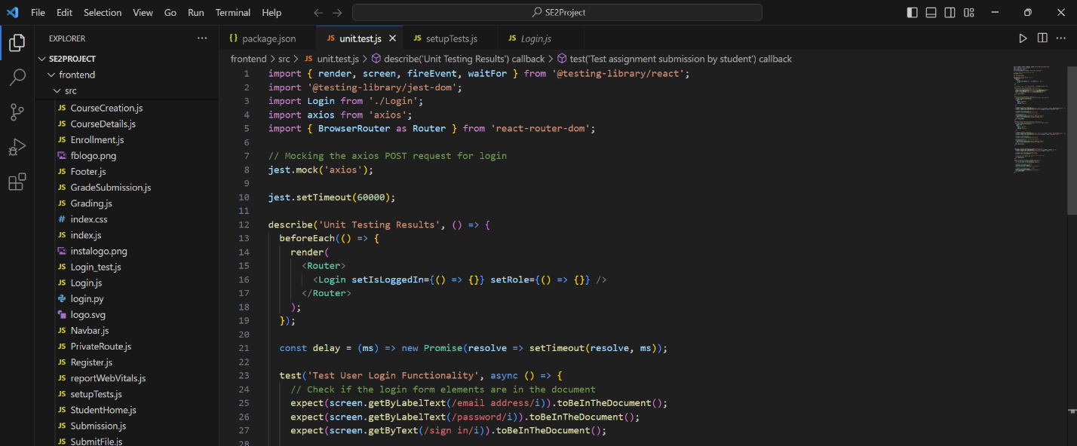
Unit Testing Code Snaps

Slide 28
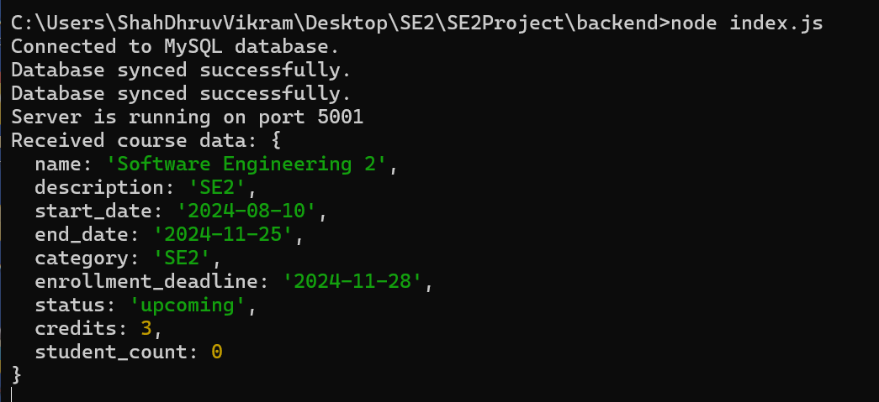
Unit Testing Code Snaps

Slide 29
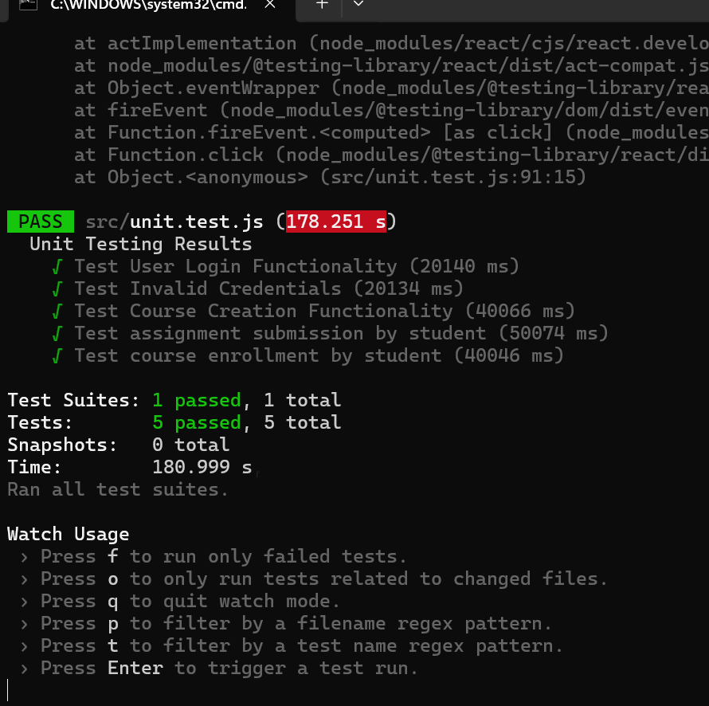
Testing Results

Slide 30
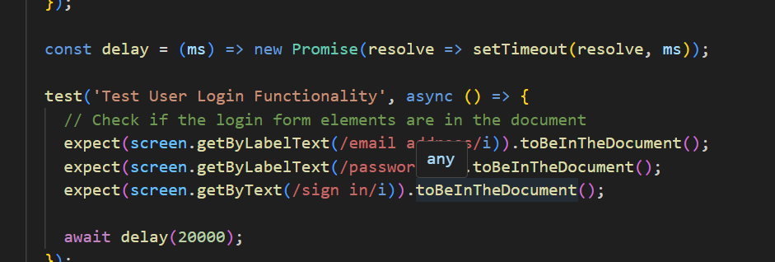
Bugs/Issues Found
While running the test cases, a common issue encountered was timeouts, which were primarily caused by slow page rendering.
To solve this, we added a delay time so that it can be properly loaded and also gave an estimated time also for that
Testing Tools and Framework
Jest
Visual Studio Code

Slide 31
Risk Factors
Development Challenges: Delays in integrating frontend and backend
.
Compatibility Issues: Browser or device inconsistencies.
Performance Risks: Slow page loads due to inefficient queries.
System Downtime: Server crashes from overload.
Security Vulnerabilities: Risk of unauthorized data access.
User Experience Challenges: Bugs in key user workflows.
Integration Issues: API and database synchronization errors.
Scalability Concerns: Limited capacity for high user volumes.

Slide 32
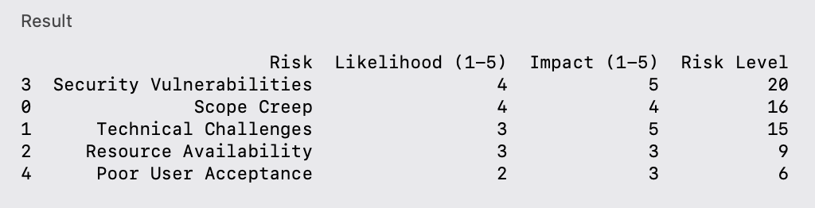
Risk Assessment

Slide 33
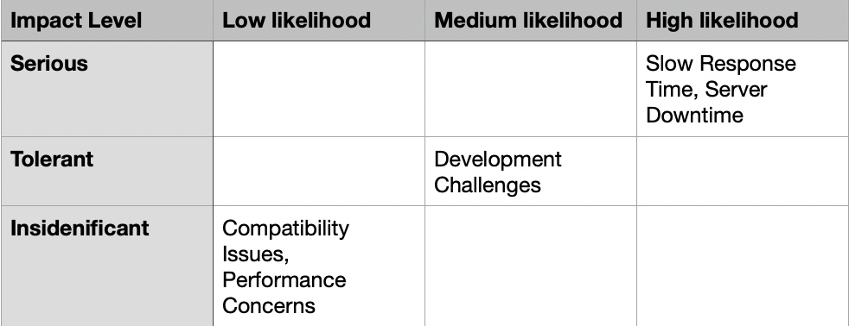
Risk Mitigation Plan

Slide 34
Quality Assurance
Functionality: Ensure all features (e.g., user authentication, course management) work correctly.
Reliability: System must handle heavy usage without failure.
Usability: Easy and intuitive interface for users across devices.
Performance: Fast response times, even with large user bases.
Security: Protect user data and system access (e.g., encryption, secure authentication).
Scalability: Ability to grow without performance issues.
Maintainability: Modular, well-documented code for easy updates.
Compatibility: Works on various devices and browsers.

Slide 35
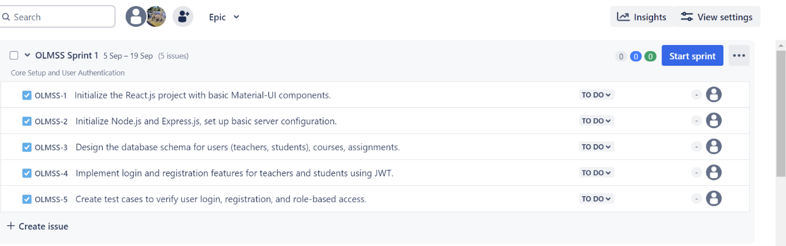
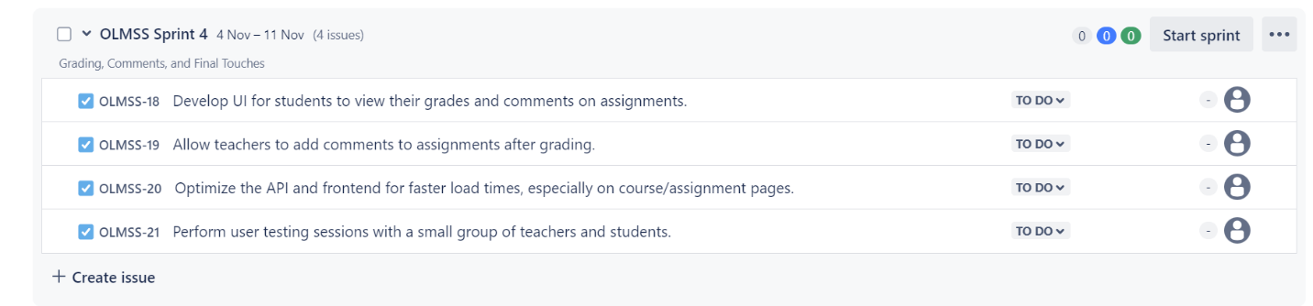
Management Tools

Slide 36
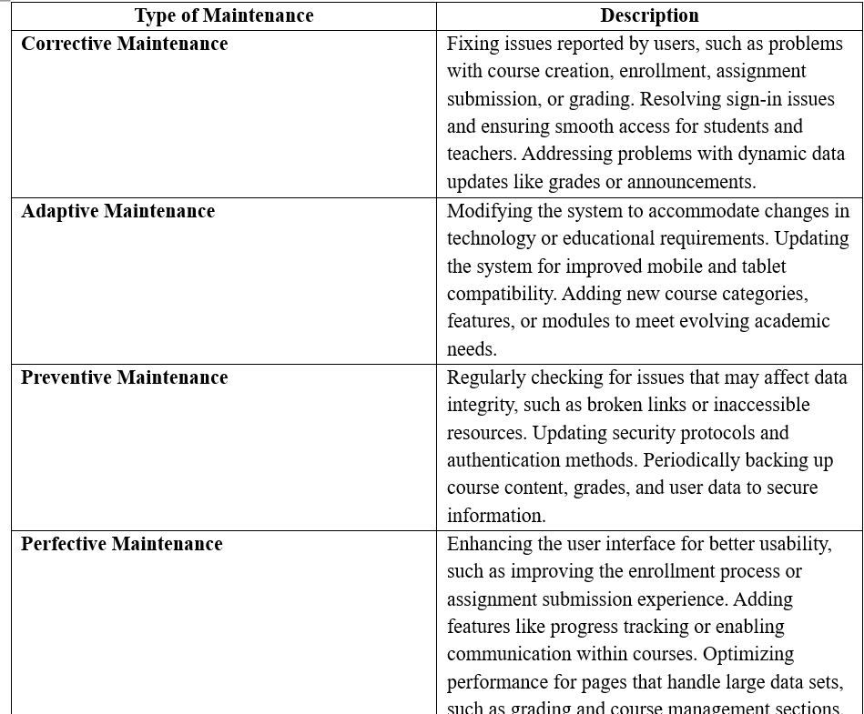
Maintenance

Slide 37
Future Scope
Integration with External Tools and Platforms
Integrating with popular learning tools such as Google Classroom, Zoom, or Microsoft Teams to enhance the collaborative and interactive experience.
AI-Powered Recommendations
Implementing AI features to recommend courses, assignments, or resources based on student preferences, performance, and learning patterns.
Mobile Application Development
Developing native mobile apps for iOS and Android to provide a better mobile experience for students and teachers, including offline access to course materials.
Advanced Analytics and Reporting
Incorporating more advanced analytics features to help teachers track student progress, identify struggling students, and generate detailed reports for course management.
Gamification
Adding gamification elements like badges, leaderboards, and achievements to engage students and encourage participation.
Enhanced Communication Features
Introducing real-time chat or forums within the system to allow students and teachers to collaborate more efficiently.

Slide 38
References
https://developer.mozilla.org/en-US/
https://sequelize.org/docs/v6/getting-started/
https://legacy.reactjs.org/docs/getting-started.html
https://github.com/mui/material-ui
https://www.nodemailer.com/
https://github.com/react-rev/RLMS

Slide 39
THANK YOU!

